Slide 1
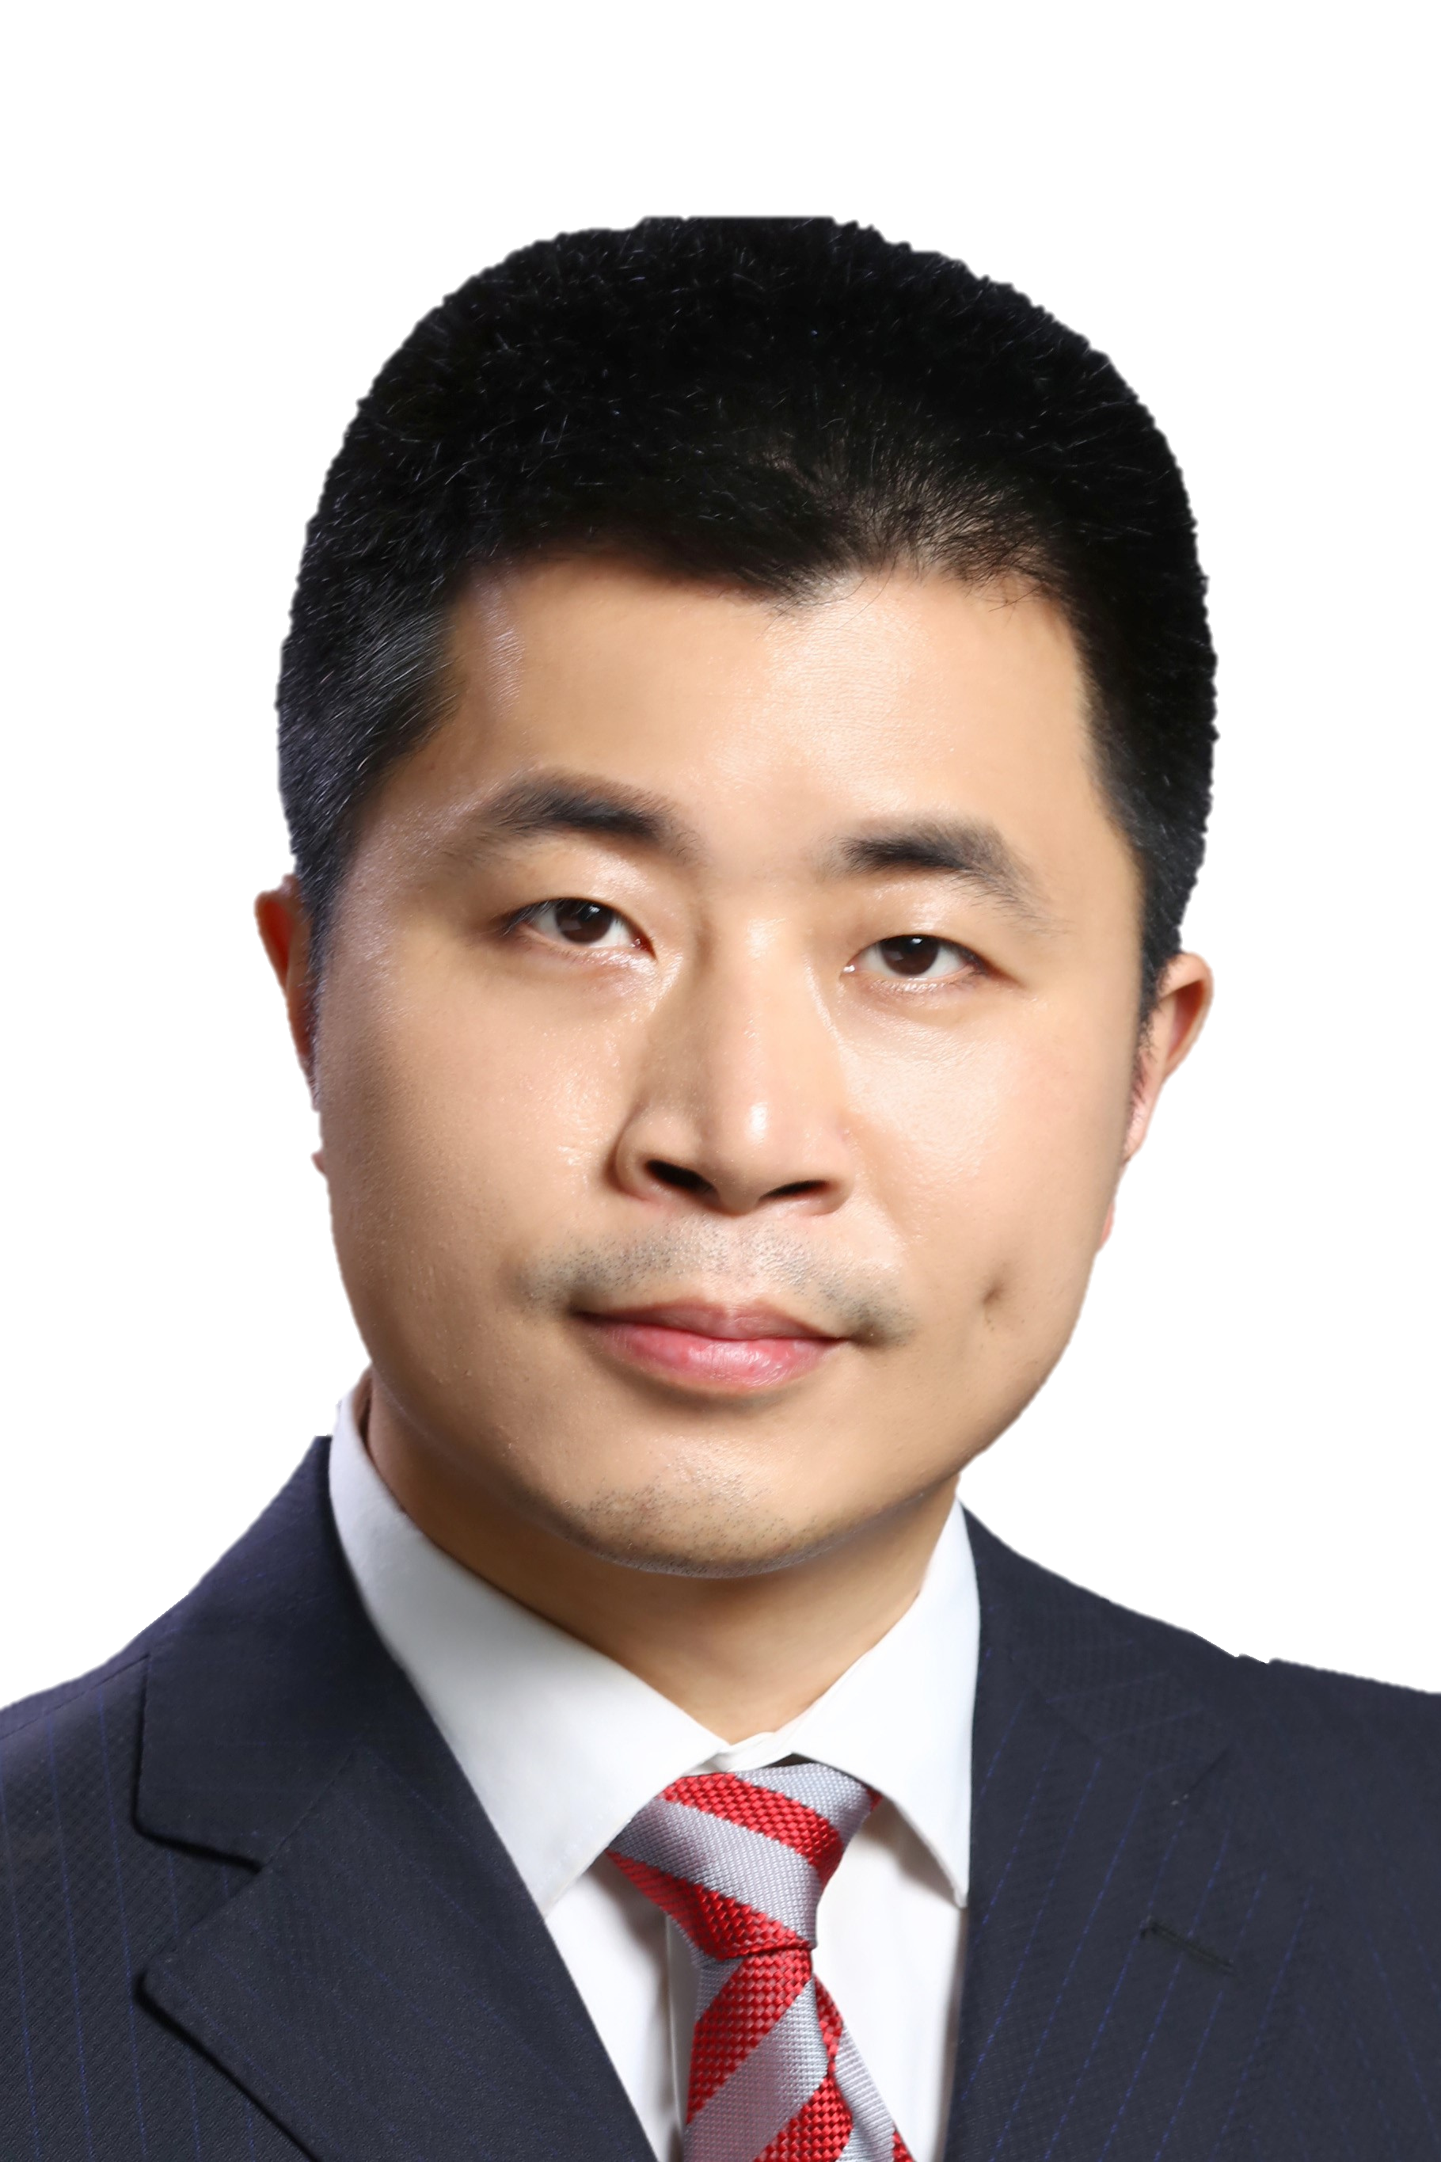


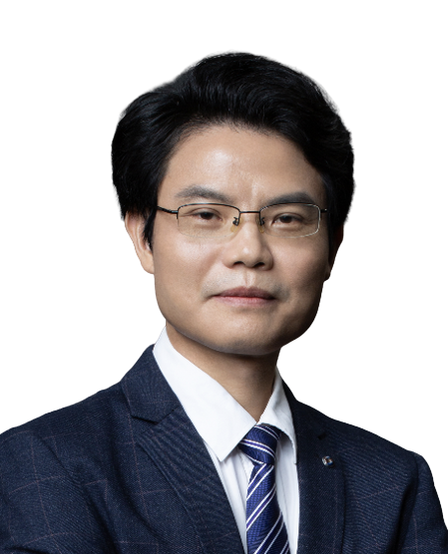
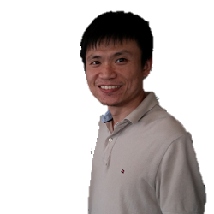
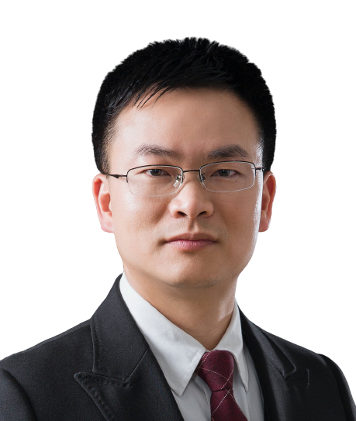
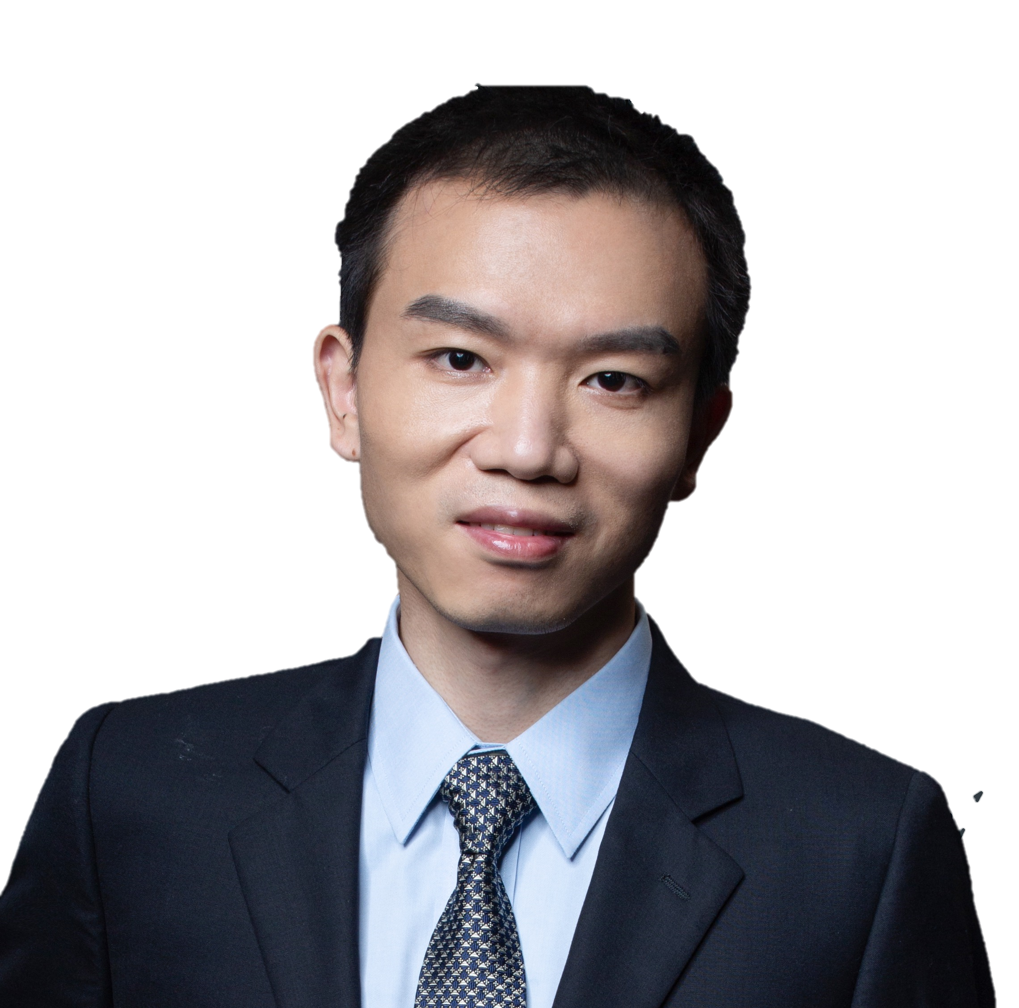
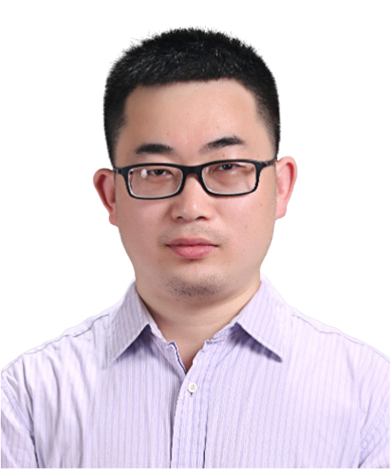


Epigenetic Programming and Reprogramming in Mammals at the Beginning of Life
Lecture Location: Room 102, Lecture Hall, Building 2, School of Life Sciences, Sun Yat-sen University
Time (China): 2024-09-27 09:30
Tencent Meeting: 959-378-696
Bilibili：https://live.bilibili.com/26427894
Dr. Falong Lu
Institute of Genetics and Developmental Biology, Chinese Academy of Sciences
Abstract:
Extensive epigenetic programming and reprogramming take place in the mammalian early embryos after fertilization to start the life program of new individuals, at both the chromatin level and the RNA level. At the chromatin level, we reveal the dynamics and regulation of chromatin accessibility during early embryonic development and identify a new type of non-canonically imprinted genes in the pre-implantation embryo that are regulated by tri-methylation at the lysine 27 of histone H3 (H3K27me3). We reveal that the non-canonical imprinting plays an important role in post-implantation embryonic development. At the RNA level, we reveal the presence of widespread non-A residues within the body of RNA poly(A) tails which may encode a new layer of RNA epigenetic regulatory information. We reveal mRNA poly(A) tail-mediated maternal mRNA remodeling in the human early embryos, and its critical role for the first cell division of the human embryos. These findings not only reveal novel epigenetic regulatory mechanisms, but also shed lights on our understanding of the regulatory mechanisms underlying the start of a mammalian individual.
HOST＆PANELISTS
Host： Jianhua Yang
Sun Yat-sen University
LuoGuan zheng
Sun Yat-sen University
Lin Huang
Sun Yat-sen University
Gang Wan
Sun Yat-sen University
Jinkai Wang
Sun Yat-sen University
Sponsors

Slide 2
哺乳动物生命起始阶段表观遗传编程与重编程
讲座地点： 中山大学生命科学楼2号楼102讲学厅
北京时间： 2024-09-27 09:30
腾讯会议: 959-378-696
哔哩哔哩： https://live.bilibili.com/26427894
陆发隆
中国科学院遗传与发育生物学研究所
研究员
简介：
陆发隆，博士，中国科学院遗传与发育生物学研究所研究员，2004年获北京大学学士学位，2011年获中国科学院遗传与发育生物学研究所博士学位，2012-2017年在波士顿儿童医院/哈佛大学医学院/霍华德休斯医学研究所从事博士后训练。2017起任中国科学院遗传与发育生物学研究所研究员，入选国家高层次引进人才青年项目。主要研究表观遗传调控，在poly(A)尾编码的表观遗传信息解码新技术，表观遗传修饰写入擦除与读取的新机制，和胚胎发育的表观遗传调控新机制与提升体细胞克隆效率的新策略等方面取得了一系列原创和有引领性的成果，相关成果以第一或通讯作者（含共同）发表在Cell、Nature、Nature Genetics、Nature Structural & Molecular Biology、Cell Stem Cell、Developmental Cell、Nature Communications和PNAS等期刊；被引超过 5000次，H-index 29。担任eLife、Science China Life Sciences和National Science Review等期刊编委。
主持人＆嘉宾
杨建华
中山大学
骆观正
中山大学
黄林
中山大学
万刚
中山大学
王金凯
中山大学
赞助商

